Slide 1
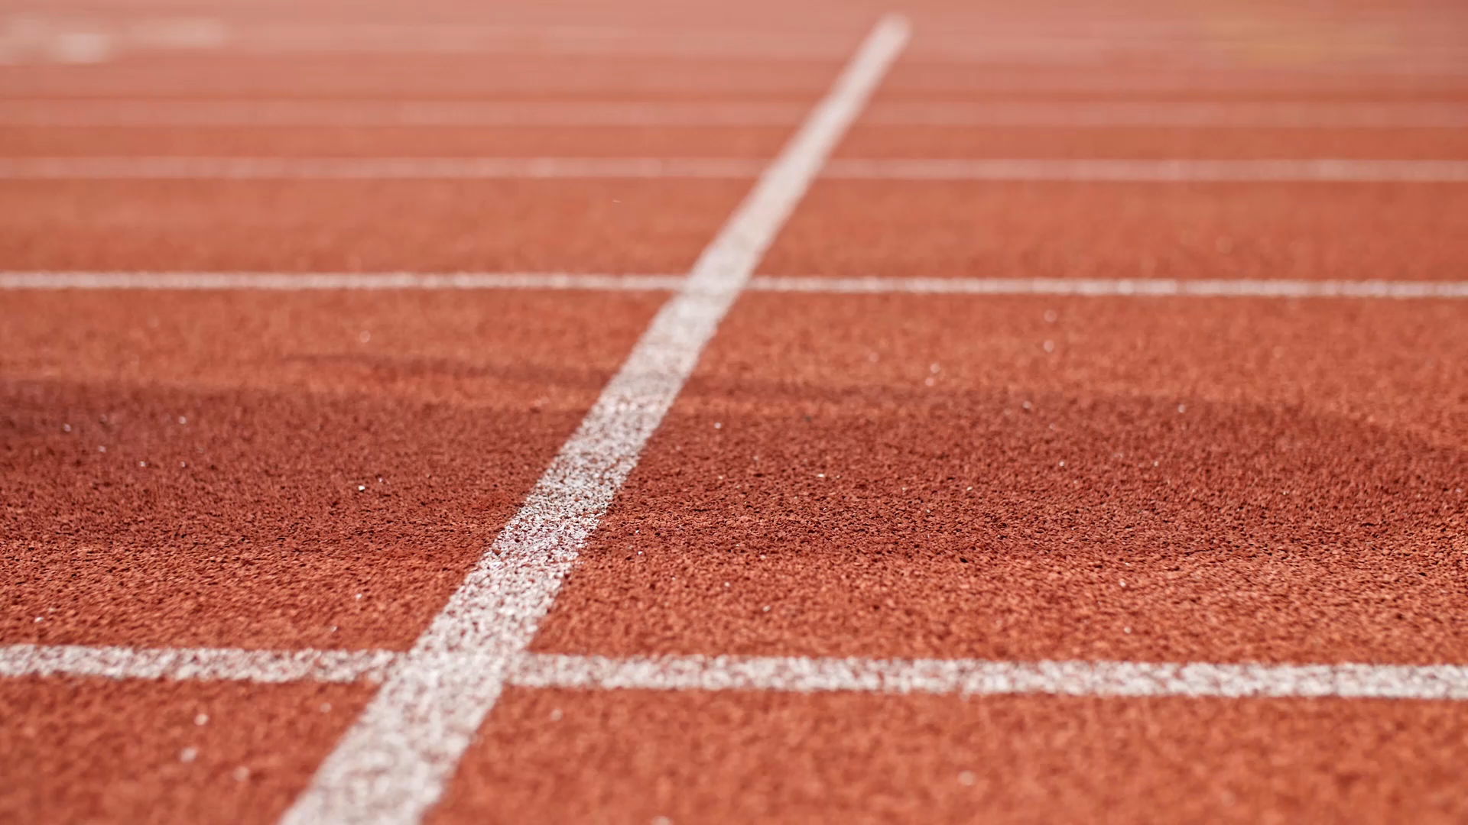
The Estimated Probability of Competing in College Athletics
By: Shanysse Alexander

Slide 2
Table Of Contents
Introduction
CTEC 298 Overview
Overview of The Data
Bar Plot
Pie Chart
Histogram
Scatter Plot
Stack Plot
Summary

Slide 3

Introduction
There are many young athletes who wish to compete at the next level in college. But not all high school will transition into becoming collegiate athletes.
Many factors are at play such as talent level, exposure, and even what specific high school you attend.

Slide 4
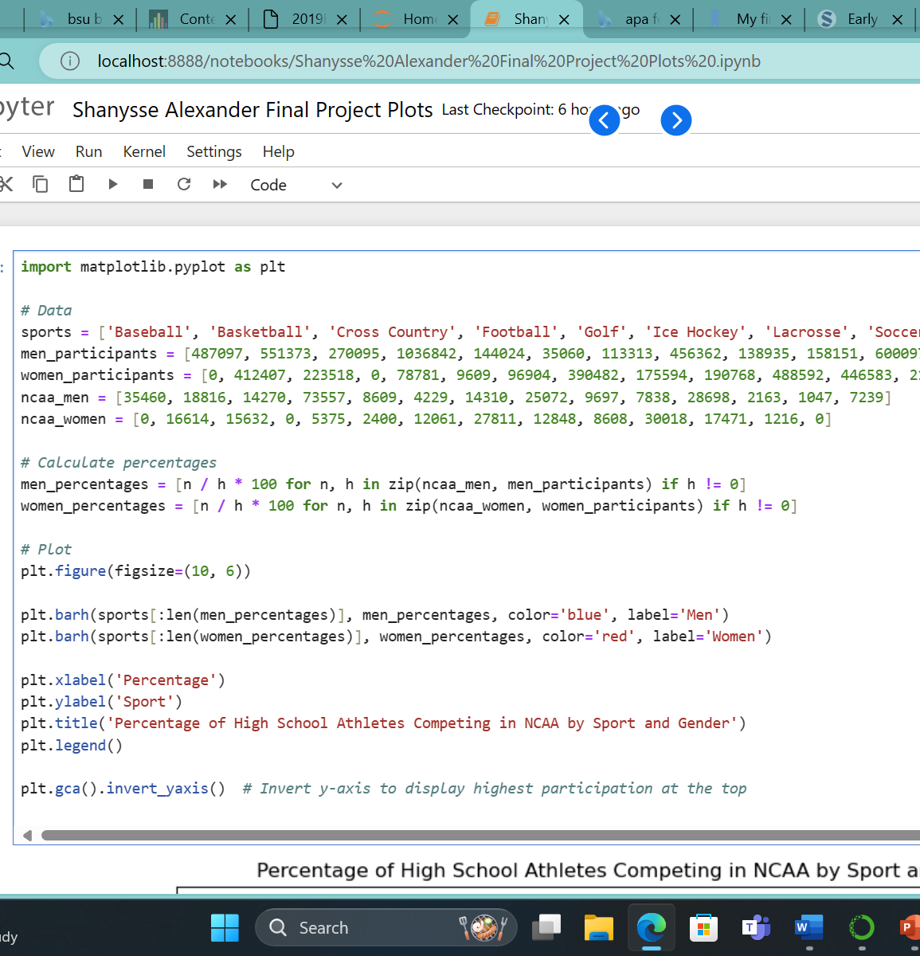
CTEC 298 Overview
In this class we used several different repositories to store our work such as Google Drive, GitHub, and Jupyter Notebbook.
For my data set I used Python to create the different plots and uploaded the data into Jupyter Notebook to get the image of my plots.

Slide 5
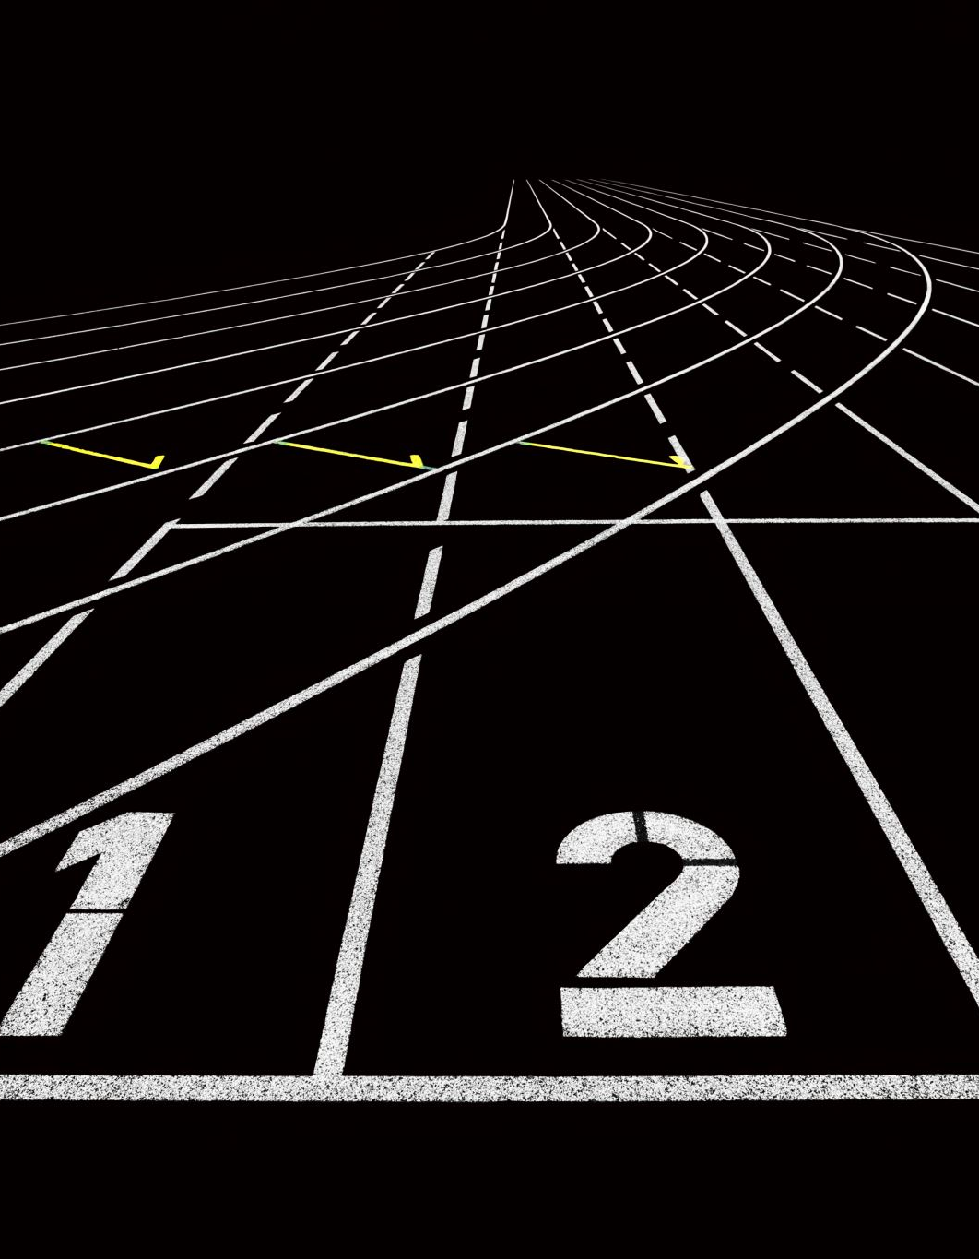
Overview Of The Data
The NCAA conducted a survey in 2017 in which they surveyed high school athletes and asked what sport they play.
The NCAA compared these numbers to the number of male and female athletes who play at the collegiate level spread through out Division I, II, and II.
This study showed the percentages of high school athletes that transition over to playing in college.

Slide 6
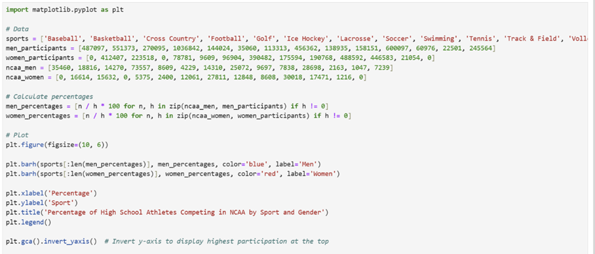
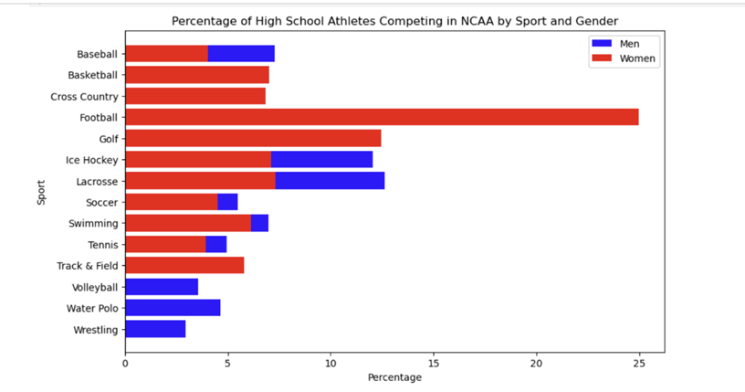
Bar Plot
The bar plot shows the percentages of male and female athlete competing the NCAA by sport.
The red represents the female athletes, and the blue represents the male athletes

Slide 7
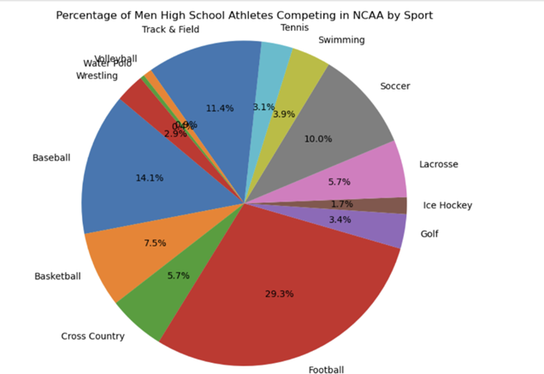
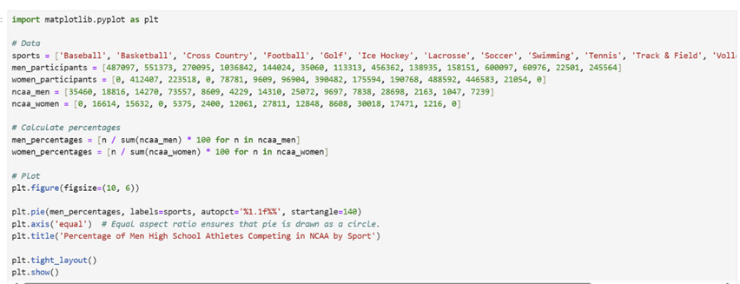
Pie Chart
The pie chart shows the percentage of male athletes that compete in the NCAA by sport
This chart gives a closer look at the breakdown of how many athletes are playing each specific sport.

Slide 8
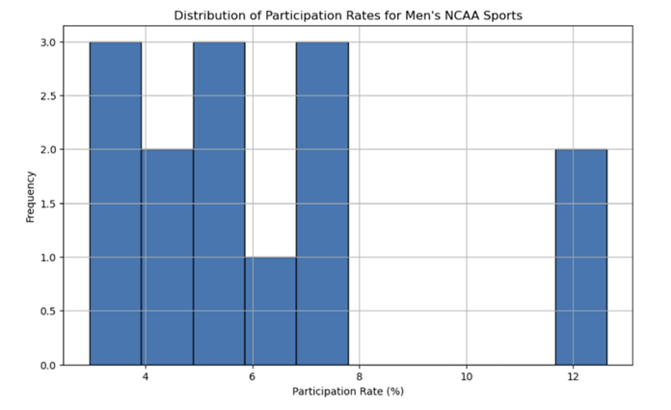
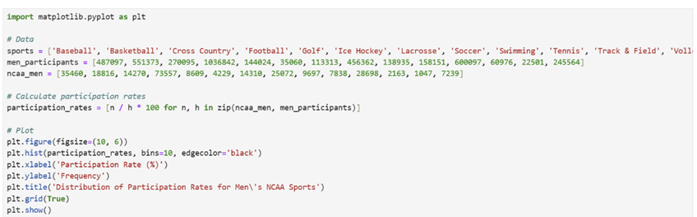
Histogram
The histogram shows the distribution of participation rates for Men’s NCAA sports.
From the graph you can tell there is a gap in the data for the participation rate.

Slide 9
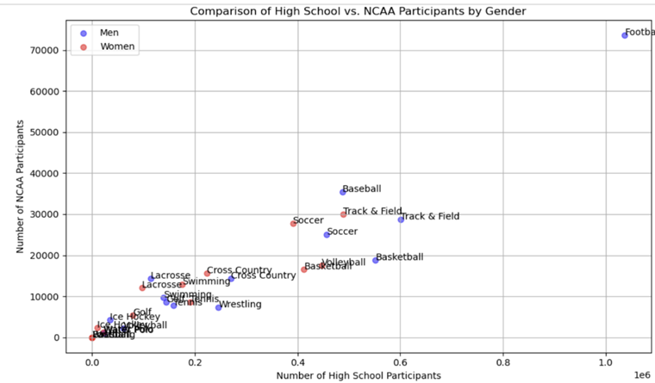
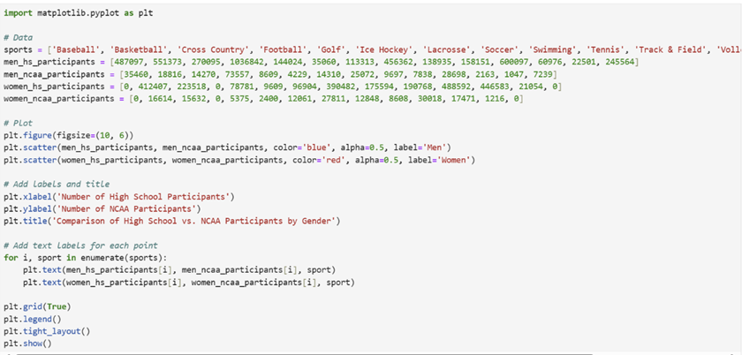
Scatter Plot
The scatter plot shows the comparison of high school athletes to NCAA athletes
From the data you can tell there is a much smaller number of NCAA athletes versus high school athletes

Slide 10
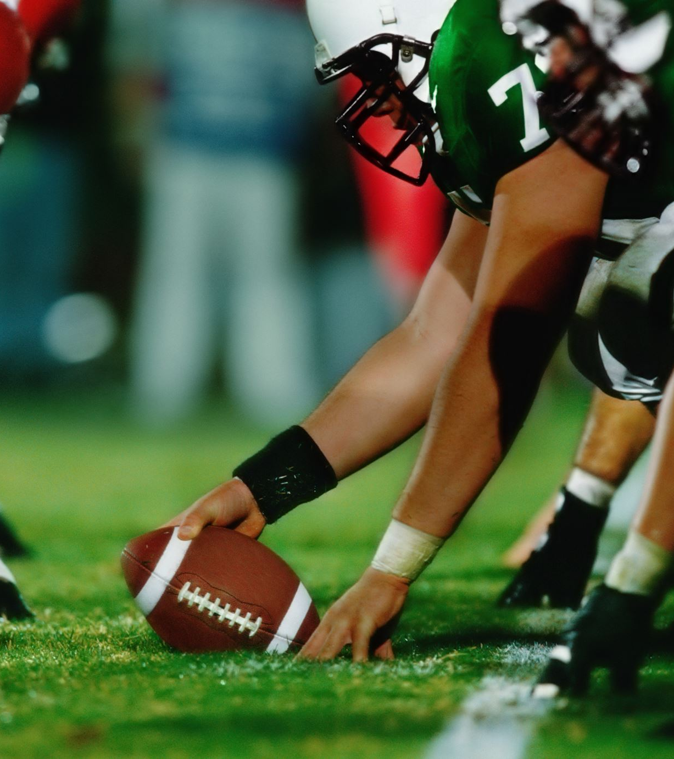
Summary
From the data you can determine that if you are a high school athlete and you hope to play in college your chances of playing are just under 30% or less based what sport you play.
The highest chances of playing a sport in college are if you are a male lacrosse player (12.6%)
For a female the highest chances of playing a sport in college are if you are a ice hockey player (25.0%)

Slide 11
References
Estimated Probability of Competing in College Athletics High School Participants NCAA Participants Overall % HS to NCAA % HS to NCAA Division I % HS to NCAA Division II % HS to NCAA Division III Men. (n.d.). https://ncaaorg.s3.amazonaws.com/research/pro_beyond/2019RES_ProbabilityBeyondHSFiguresMethod.pdf

